Slide 1
Module 9: Cloud Architecture
AWS Academy Cloud Foundations
Notes:
Module 9: Cloud Architecture

Slide 2

Module overview
Topics
AWS Well-Architected Framework
Reliability and high availability
AWS Trusted Advisor
Activities
AWS Well-Architected Framework Design Principles
Interpret AWS Trusted Advisor Recommendations
Knowledge check
Notes:
This module will address the following topics:
AWS Well-Architected Framework
Reliability and high availability
AWS Trusted Advisor
The module also includes two activities. In one activity, you will be challenged to review an architecture and evaluate it against the AWS Well-Architected Framework design principles. In the second activity, you will gain experience interpreting AWS Trusted Advisor recommendations.
Finally, you will be asked to complete a knowledge check that will test your understanding of key concepts covered in this module.

Slide 3
Module objectives
After completing this module, you should be able to:
Describe the AWS Well-Architected Framework, including the six pillars
Identify the design principles of the AWS Well-Architected Framework
Explain the importance of reliability and high availability
Identify how AWS Trusted Advisor helps customers
Interpret AWS Trusted Advisor recommendations
Notes:
After completing this module, you should be able to:
Describe the AWS Well-Architected Framework, including the six pillars
Identify the design principles of the AWS Well-Architected Framework
Explain the importance of reliability and high availability
Identify how AWS Trusted Advisor helps customers
Interpret AWS Trusted Advisor recommendations

Slide 4
Section 1: AWS Well-Architected Framework
Module 9: Cloud Architecture
Notes:
Section 1: AWS Well-Architected Framework

Slide 5




Architecture: designing and building
Architect
Structure design
Customer (Decision maker)
Completed structure
Building crew (Delivery team)
Notes:
Architecture is the art and science of designing and building large structures. Large systems require architects to manage their size and complexity.
Cloud architects:
Engage with decision makers to identify the business goal and the capabilities that need improvement.
Ensure alignment between technology deliverables of a solution and the business goals.
Work with delivery teams that are implementing the solution to ensure that the technology features are appropriate.
Having well-architected systems greatly increases the likelihood of business success.

Slide 6
What is the AWS Well-Architected Framework?
A guide for designing infrastructures that are:
Secure
High-performing
Resilient
Efficient
A consistent approach to evaluating and implementing cloud architectures
A way to provide best practices that were developed through lessons learned by reviewing customer architectures
Notes:
The AWS Well-Architected Framework is a guide that is designed to help you build the most secure, high-performing, resilient, and efficient infrastructure possible for your cloud applications and workloads. It provides a set of foundational questions and best practices that can help you evaluate and implement your cloud architectures. AWS developed the Well-Architected Framework after reviewing thousands of customer architectures on AWS.

Slide 7
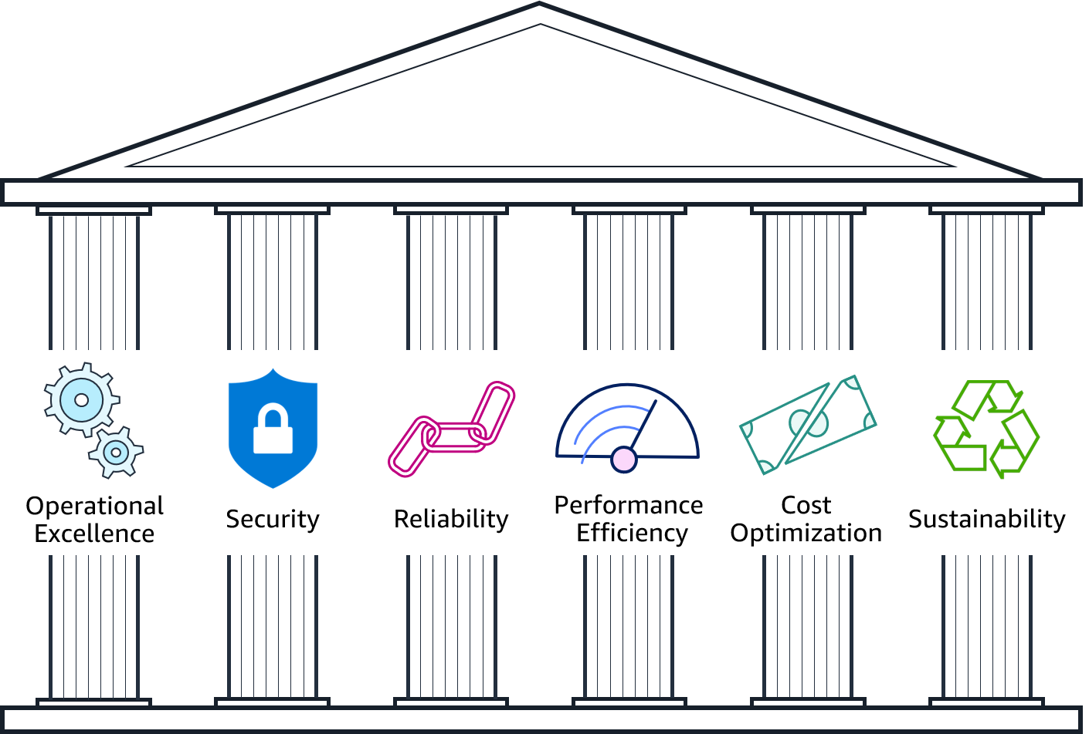
Pillars of the AWS Well-Architected Framework
Notes:
The AWS Well-Architected Framework is organized into six pillars: operational excellence, security, reliability, performance efficiency, cost optimization, and sustainability. The first five pillars have been part of the framework since the framework's introduction in 2015. The sustainability pillar was added as the sixth pillar in 2021 to help organizations learn how to minimize the environmental impacts of running cloud workloads.
The remainder of this module focuses on the first five pillars (operational excellence, security, reliability, performance efficiency, cost optimization) and leads you through a review of an example architecture against each pillar's design principles.
For more about the sustainability pillar, refer to the sustainability pillar section within the Well-Architected Framework documentation see https://docs.aws.amazon.com/wellarchitected/latest/sustainability-pillar/sustainability-pillar.html.
For accessibility: The pillars include operational excellence, security, reliability, performance efficiency, cost optimization, and sustainability. End of accessibility description.

Slide 8
Pillar organization
Best practice area
Identity and Access Management
SEC 1: How do you manage credentials and authentication?
Credential and authentication mechanisms include passwords, tokens, and keys that grant access directly or indirectly in your workload. Protect credentials with appropriate mechanisms to help reduce the risk of accidental or malicious use.
Best practices:
Define requirements for identity and access management
Secure AWS account root user
Enforce use of multi-factor authentication
Automate enforcement of access controls
Integrate with centralized federation provider
Enforce password requirements
Rotate credentials regularly
Audit credentials periodically
Question text
Question context
Best practices
Notes:
Each pillar includes a set of design principles and best practice areas. Each best practice area aligns to questions a reviewer should ask when designing an architecture. The questions for each pillar are part of the Well-Architected Framework Appendix.

Slide 9
Operational Excellence pillar
Notes:
Operational Excellence pillar

Slide 10

Operational Excellence pillar – deliver business value
Operational Excellence
pillar
Focus
Run and monitor systems to deliver business value, and to continually improve supporting processes and procedures.
Key topics
Automating changes
Responding to events
Defining standards to manage daily operations
Deliver business value
Notes:
The Operational Excellence pillar focuses on the ability to run and monitor systems to deliver business value, and to continually improve supporting processes and procedures. Key topics include: automating changes, responding to events, and defining standards to manage daily operations.

Slide 11
Operational excellence design principles
Operational Excellence
pillar
Perform operations as code
Make frequent, small, reversible changes
Refine operations procedures frequently
Anticipate failure
Learn from all operational events and failures
Deliver business value
Notes:
There are five design principles for operational excellence in the cloud:
Perform operations as code – Define your entire workload (that is, applications and infrastructure) as code and update it with code. Implement operations procedures as code and configure them to automatically trigger in response to events. By performing operations as code, you limit human error and enable consistent responses to events.
Make frequent, small, reversible changes – Design workloads to enable components to be updated regularly. Make changes in small increments that can be reversed if they fail (without affecting customers when possible).
Refine operations procedures frequently – Look for opportunities to improve operations procedures. Evolve your procedures appropriately as your workloads evolve. Set up regular game days to review all procedures, validate their effectiveness, and ensure that teams are familiar with them.
Anticipate failure – Identify potential sources of failure so that they can be removed or mitigated. Test failure scenarios and validate your understanding of their impact. Test your response procedures to ensure that they are effective and that teams know how to run them. Set up regular game days to test workloads and team responses to simulated events.
Learn from all operational failures – Drive improvement through lessons learned from all operational events and failures. Share what is learned across teams and through the entire organization.

Slide 12
Operational excellence questions
Organization
How do you determine what your priorities are?
How do you structure your organization to support your business outcomes?
How does your organizational culture support your business outcomes?
Prepare
How do you design your workload so that you can understand its state?
How do you reduce defects, ease remediation, and improve flow into production?
How do you mitigate deployment risks?
How do you know that you are ready to support a workload?
Operate
How do you understand the health of your workload?
How do you understand the health of your operations?
How do you manage workload and operations events?
Evolve
How do you evolve operations?
Notes:
The foundational questions for operational excellence fall under three best practice areas: organization, prepare, operate, and evolve.
Operations teams must understand business and customer needs so they can effectively and efficiently support business outcomes. Operations teams create and use procedures to respond to operational events and validate the effectiveness of procedures to support business needs. Operations teams collect metrics that are used to measure the achievement of desired business outcomes. As business context, business priorities, and customer needs, change over time, it’s important to design operations that evolve in response to change and to incorporate lessons learned through their performance.

Slide 13
Security pillar
Notes:
Security pillar

Slide 14

Security pillar – protect and monitor systems
Security
pillar
Focus
Protect information, systems, and assets while delivering business value through risk assessments and mitigation strategies.
Key topics
Protecting confidentiality and integrity of data
Identifying and managing who can do what
Protecting systems
Establishing controls to detect security events
Protect and monitor systems
Notes:
The Security pillar focuses on the ability to protect information, systems, and assets while delivering business value through risk assessments and mitigation strategies. Key topics include: protecting confidentiality and integrity of data, identifying and managing who can do what (or privilege management), protecting systems, and establishing controls to detect security events.

Slide 15
Security design principles
Security
pillar
Implement a strong identity foundation
Enable traceability
Apply security at all layers
Automate security best practices
Protect data in transit and at rest
Keep people away from data
Prepare for security events
Protect and monitor systems
Notes:
There are seven design principles that can improve security:
Implement a strong identity foundation – Implement the principle of least privilege and enforce separation of duties with appropriate authorization for each interaction with your AWS resources. Centralize privilege management and reduce or even eliminate reliance on long-term credentials.
Enable traceability – Monitor, alert, and audit actions and changes to your environment in real time. Integrate logs and metrics with systems to automatically respond and take action.
Apply security at all layers – Apply defense in depth and apply security controls to all layers of your architecture (for example, edge network, virtual private cloud, subnet, and load balancer; and every instance, operating system, and application).
Automate security best practices – Automate security mechanisms to improve your ability to securely scale more rapidly and cost effectively. Create secure architectures and implement controls that are defined and managed as code in version-controlled templates.
Protect data in transit and at rest – Classify your data into sensitivity levels and use mechanisms such as encryption, tokenization, and access control where appropriate.
Keep people away from data – To reduce the risk of loss or modification of sensitive data due to human error, create mechanisms and tools to reduce or eliminate the need for direct access or manual processing of data.
Prepare for security events – Have an incident management process that aligns with organizational requirements. Run incident response simulations and use tools with automation to increase your speed of detection, investigation, and recovery.

Slide 16
Security questions
Security
How do you securely operate your workload?
Identity and access management
How do you manage identities for people and machines?
How do you manage permissions for people and machines?
Detection
How do you detect and investigate security events?
Infrastructure protection
How do you protect your network resources?
How do you protect your compute resources?
Data protection
How do you classify your data?
How do you protect your data at rest?
How do you protect your data in transit?
Incident response
How do you anticipate, respond to, and recover from incidents?
Notes:
The foundational questions for security fall under six best practice areas: security, identity and access management, detection, infrastructure protection, data protection, and incident response.
Before you architect any system, you must put security practices in place. You must be able to control who can do what. In addition, you must be able to identify security incidents, protect your systems and services, and maintain the confidentiality and integrity of data through data protection. You should have a well-defined and practiced process for responding to security incidents. These tools and techniques are important because they support objectives such as preventing financial loss or complying with regulatory obligations.

Slide 17
Reliability pillar
Notes:
Reliability pillar

Slide 18

Reliability pillar – recover from failure and mitigate disruption
Reliability
pillar
Focus
Ensure a workload performs its intended function correctly and consistently when it’s expected to.
Key topics
Designing distributed systems
Recovery planning
Handling change
Recover from failure and mitigate disruption.
Notes:
The Reliability pillar focuses on ensuring a workload performs its intended function correctly and consistently when it’s expected to. A resilient workload quickly recovers from failures to meet business and customer demand. Key topics include: designing distributed systems, recovery planning, and handling change.

Slide 19
Reliability design principles
Reliability
pillar
Automatically recover from failure
Test recovery procedures
Scale horizontally to increase aggregate workload availability
Stop guessing capacity
Manage change in automation
Recover from failure and mitigate disruption.
Notes:
There are five design principles that can increase reliability:
Automatically recover from failure – Monitor systems for key performance indicators and configure your systems to trigger an automated recovery when a threshold is breached. This practice enables automatic notification and failure-tracking, and for automated recovery processes that work around or repair the failure.
Test recovery procedures – Test how your systems fail and validate your recovery procedures. Use automation to simulate different failures or to recreate scenarios that led to failures before. This practice can expose failure pathways that you can test and rectify before a real failure scenario.
Scale horizontally to increase aggregate workload availability – Replace one large resource with multiple, smaller resources and distribute requests across these smaller resources to reduce the impact of a single point of failure on the overall system.
Stop guessing capacity – Monitor demand and system usage, and automate the addition or removal of resources to maintain the optimal level for satisfying demand.
Manage change in automation – Use automation to make changes to infrastructure and manage changes in automation.

Slide 20
Reliability questions
Foundations
How do you manage service quotas and constraints?
How do you plan your network topology?
Workload architecture
How do you design your workload service architecture?
How do you design interactions in a distributed system to prevent failure?
How do you design interactions in a distributed system to mitigate or withstand failures?
Change management
How do you monitor workload resources?
How do you design your workload to adapt to changes in demand?
How do you implement change?
Failure management
How do you back up data?
How do you use fault isolation to protect your workload?
How do you design your workload to withstand component failures?
How do you test reliability?
How do you plan for disaster recovery?
Notes:
The foundational questions for reliability fall under four best practice areas: foundations, workload architecture, change management, and failure management.
To achieve reliability, a system must have both a well-planned foundation and monitoring in place. It must have mechanisms for handling changes in demand or requirements. The system should be designed to detect failure and automatically heal itself.

Slide 21
Performance Efficiency pillar
Notes:
Performance Efficiency pillar

Slide 22

Performance Efficiency pillar – use resources sparingly
Performance Efficiency
pillar
Focus
Use IT and computing resources efficiently to meet system requirements and to maintain that efficiency as demand changes and technologies evolve.
Key topics
Selecting the right resource types and sizes based on workload requirements
Monitoring performance
Making informed decisions to maintain efficiency as business needs evolve
Use resources sparingly.
Notes:
The Performance Efficiency pillar focuses on the ability to use IT and computing resources efficiently to meet system requirements, and to maintain that efficiency as demand changes or technologies evolve. Key topics include: selecting the right resource types and sizes based on workload requirements, monitoring performance, and making informed decisions to maintain efficiency as business needs evolve.

Slide 23
Performance efficiency design principles
Performance Efficiency
pillar
Democratize advanced technologies
Go global in minutes
Use serverless architectures
Experiment more often
Consider mechanical sympathy
Use resources sparingly.
Notes:
There are five design principles that can improve performance efficiency:
Democratize advanced technologies – Consume technologies as a service. For example, technologies such as NoSQL databases, media transcoding, and machine learning require expertise that is not evenly dispersed across the technical community. In the cloud, these technologies become services that teams can consume. Consuming technologies enables teams to focus on product development instead of resource provisioning and management.
Go global in minutes – Deploy systems in multiple AWS Regions to provide lower latency and a better customer experience at minimal cost.
Use serverless architectures – Serverless architectures remove the operational burden of running and maintaining servers to carry out traditional compute activities. Serverless architectures can also lower transactional costs because managed services operate at cloud scale.
Experiment more often – Perform comparative testing of different types of instances, storage, or configurations.
Consider mechanical sympathy – Use the technology approach that aligns best to what you are trying to achieve. For example, consider your data access patterns when you select approaches for databases or storage.

Slide 24
Performance efficiency questions
Selection
How do you select the best performing architecture?
How do you select your compute solution?
How do you select your storage solution?
How do you select your database solution?
How do you configure your networking solution?
Review
How do you evolve your workload to take advantage of new releases?
Monitoring
How do you monitor your resources to ensure they are performing?
Tradeoffs
How do you use tradeoffs to improve performance?
Notes:
The foundational questions for performance efficiency fall under four best practice areas: selection, review, monitoring, and tradeoffs.
Use data to design and build a high-performance architecture. Gather data on all aspects of the architecture, from the high-level design to the selection and configuration of resource types. Review your choices periodically to ensure that you are taking advantage of new AWS services. Perform monitoring so that you are aware of any deviance from expected performance and can take prompt action to remediate them. Finally, use tradeoffs in your architecture to improve performance, such as using compression, using caching, or relaxing consistency requirements.

Slide 25
Cost Optimization pillar
Notes:
Cost Optimization pillar

Slide 26

Cost Optimization pillar – eliminate unneeded expense
Cost Optimization pillar
Focus
Avoid unnecessary costs.
Key topics
Understanding and controlling where money is being spent
Selecting the most appropriate and right number of resource types
Analyzing spend over time
Scaling to meeting business needs without overspending
Eliminate unneeded expense.
Notes:
The Cost Optimization pillar focuses on the ability to avoid unnecessary costs. Key topics include: understanding and controlling where money is being spent, selecting the most appropriate and right number of resource types, analyzing spend over time, and scaling to meeting business needs without overspending.

Slide 27
Cost optimization design principles
Cost Optimization pillar
Implement Cloud Financial Management
Adopt a consumption model
Measure overall efficiency
Stop spending money on undifferentiated heavy lifting
Analyze and attribute expenditure
Eliminate unneeded expense.
Notes:
There are five design principles that can optimize costs:
Implement Cloud Financial Management – To achieve financial success and accelerate business value realization in the cloud, you need to invest in cloud financial management and cost optimization. You need to build capability through knowledge building, programs, resources, and processes to become a cost-efficient organization.
Adopt a consumption model – Pay only for the computing resources that you require. Increase or decrease usage depending on business requirements, not by using elaborate forecasting.
Measure overall efficiency – Measure the business output of the workload and the costs that are associated with delivering it. Use this measure to know the gains that you make from increasing output and reducing costs.
Stop spending money on undifferentiated heavy lifting – AWS does the heavy lifting of racking, stacking, and powering servers, which means that you can focus on your customers and business projects instead of the IT infrastructure.
Analyze and attribute expenditure – The cloud makes it easier to accurately identify system usage and costs, and attribute IT costs to individual workload owners. Having this capability helps you measure return on investment (ROI) and gives workload owners an opportunity to optimize their resources and reduce costs.

Slide 28
Cost optimization questions
Practice cloud financial management
How do you implement cloud financial management?
Expenditure and usage awareness
How do you govern usage?
How do you monitor usage and cost?
How do you decommission resources?
Cost-effective resources
How do you evaluate cost when you select services?
How do you meet cost targets when you select resource type, size, and number?
How do you use pricing models to reduce cost?
How do you plan for data transfer changes?
Manage demand and supply resources
How do you manage demand and supply resources?
Optimize over time
How do you evaluate new services?
Notes:
The foundational questions for cost optimization fall under five best practice areas: practice cloud financial management, expenditure and usage awareness, cost-effective resources, manage demand and supply resources, and optimize over time.
Similar to the other pillars, there are tradeoffs to consider when evaluating cost. For example, you may choose to prioritize for speed—going to market quickly, shipping new features, or simply meeting a deadline—instead of investing in upfront cost optimization. As another example, designing an application for a higher level of availability typically costs more. You should identify your true application needs and use empirical data to inform your architectural design decisions. Perform benchmarking to establish the most cost-optimal workload over time.

Slide 29
The AWS Well-Architected Tool
Helps you review the state of your workloads and compares them to the latest AWS architectural best practices
Gives you access to knowledge and best practices used by AWS architects, whenever you need it
Delivers an action plan with step-by-step guidance on how to build better workloads for the cloud
Provides a consistent process for you to review and measure your cloud architectures
Notes:
The activity that you just completed is similar to how you would use the AWS Well-Architected Tool.
The AWS Well-Architected Tool helps you review the state of your workloads and compare them to the latest AWS architectural best practices. It gives you access to knowledge and best practices used by AWS architects, whenever you need it.
This tool is available in the AWS Management Console. You define your workload and answer a series of questions in the areas of operational excellence, security, reliability, performance efficiency, and cost optimization (as defined in the AWS Well-Architected Framework). The AWS Well-Architected Tool then delivers an action plan with step-by-step guidance on how to improve your workload for the cloud.
The AWS Well-Architected Tool provides a consistent process for you to review and measure your cloud architectures. You can use the results that the tool provides to identify next steps for improvement, drive architectural decisions, and bring architecture considerations into your corporate governance process.

Slide 30

Section 1 key takeaways
The AWS Well-Architected Framework provides a consistent approach to evaluate cloud architectures and guidance to help implement designs.
The AWS Well-Architected Framework documents a set of design principles and best practices that enable you to understand if a specific architecture aligns well with cloud best practices.
The AWS Well-Architected Framework is organized into six pillars.
Each pillar includes its own set of design principles and best practices.
Notes:
Some key takeaways from this section of the module include:
The AWS Well-Architected Framework provides a consistent approach to evaluate cloud architectures and guidance to help implement designs.
The AWS Well-Architected Framework documents a set of design principles and best practices that enable you to understand if a specific architecture aligns well with cloud best practices.
The AWS Well-Architected Framework is organized into six pillars.
Each pillar includes its own set of design principles and best practices.

Slide 31
Section 2: Reliability and availability
Module 9: Cloud Architecture
Notes:
Section 2: Reliability and availability

Slide 32
“Everything fails, all the time.”
Werner Vogels, CTO, Amazon.com
Notes:
In the words of Werner Vogels, Amazon’s CTO, “Everything fails, all the time.” One of the best practices that is identified in the AWS Well-Architected Framework is to plan for failure (or application or workload downtime). One way to do that is to architect your applications and workloads to withstand failure. There are two important factors that cloud architects consider when designing architectures to withstand failure: reliability and availability.

Slide 33
Reliability
A measure of your system’s ability to provide functionality when desired by the user.
System includes all system components: hardware, firmware, and software.
Probability that your entire system will function as intended for a specified period.
Mean time between failures (MTBF) = total time in service/number of failures
Car
Brakes
System Component
Ignition
Cooling
System
Component
System component
System
Notes:
Reliability is a measure of your system’s ability to provide functionality when desired by the user. Because "everything fails, all the time," you should think of reliability in statistical terms. Reliability is the probability that an entire system will function as intended for a specified period. Note that a system includes all system components, such as hardware, firmware, and software. Failure of system components impacts the availability of the system.
To understand reliability, it is helpful to consider the familiar example of a car. The car is the system. Each of the car’s components (for example, cooling, ignition, and brakes) must work together in order for the car to work properly. If you try to start the car and the ignition fails, you cannot drive anywhere—the car is not available. If the ignition fails repeatedly, your car is not considered reliable.
A common way to measure reliability is to use statistical measurements, such as Mean Time Between Failures (MTBF). MTBF is the total time in service over the number of failures.

Slide 34
Understanding reliability metrics
System brought online (system available)
Mean Time Between Failures (MTBF = MTTF + MTTR)
Mean Time to Failure (MTTF)
System (component) repaired
System (component) fails
Mean Time to Repair (MTTR)
Notes:
Say that you have an application that you bring online Monday at noon. The application is said to be available. It functions normally until it fails Friday at noon. Therefore, the time to failure (or the length of time the application is available) is 96 hours. You spend from Friday at noon until Monday at noon diagnosing why the application failed and repairing it, at which point you bring the application back online. Therefore, the time to repair is 72 hours.
Then, it happens again: the application fails on Friday at noon, you spend from Friday at noon until Monday at noon repairing it, and you bring it online on Monday at noon.
Say this failure-repair-restore cycle happens every week. You can now calculate the average of these numbers. In this example, your mean time to failure (MTTF) is 96 hours, and your mean time to repair (MTTR) is 72 hours. Your mean time between failures (MTBF) is 168 hours (or 1 week), which is the sum of MTTF and MTTR.

Slide 35
Availability
Normal operation time / total time
A percentage of uptime (for example, 99.9 percent) over time (for example, 1 year)
Number of 9s – Five 9s means 99.999 percent availability
Notes:
As you just learned, failure of system components impacts the availability of the system.
Formally, availability is the percentage of time that a system is operating normally or correctly performing the operations expected of it (or normal operation time over total time). Availability is reduced anytime the application isn’t operating normally, including both scheduled and unscheduled interruptions.
Availability is also defined as the percentage of uptime (that is, length of time that a system is online between failures) over a period of time (commonly 1 year).
A common shorthand when referring to availability is number of 9s. For example, five 9s means 99.999 percent availability.

Slide 36

High availability
System can withstand some measure of degradation while still remaining available.
Downtime is minimized.
Minimal human intervention is required.
Notes:
A highly available system is one that can withstand some measure of degradation while still remaining available. In a highly available system, downtime is minimized as much as possible and minimal human intervention is required.
A highly available system can be viewed as a set of system-wide, shared resources that cooperate to guarantee essential services. High availability combines software with open-standard hardware to minimize downtime by quickly restoring essential services when a system, component, or application fails. Services are restored rapidly, often in less than 1 minute.

Slide 37
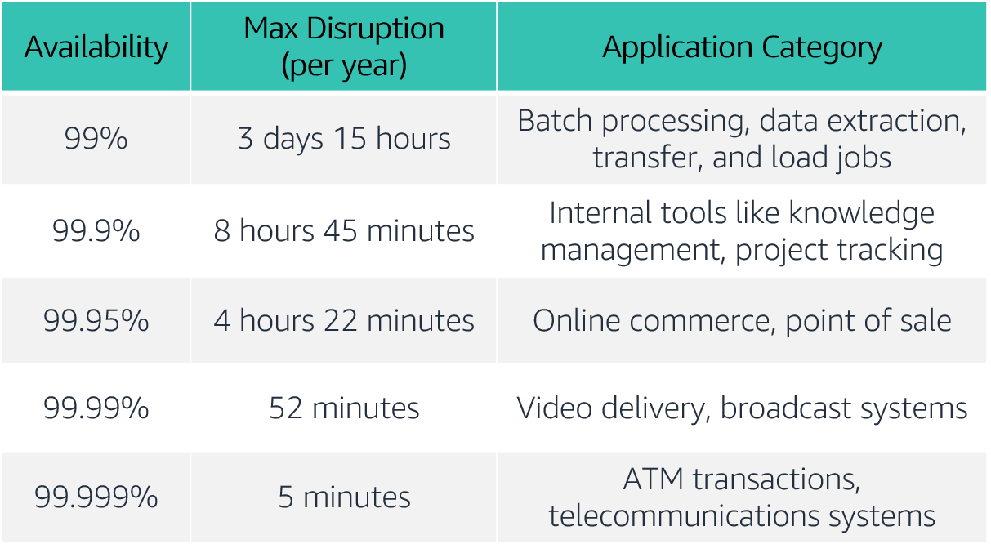
Availability tiers
Notes:
Availability requirements vary. The length of disruption that is acceptable depends on the type of application. Here is a table of common application availability design goals and the maximum length of disruption that can occur within a year while still meeting the goal. The table contains examples of the types of applications that are common at each availability tier.
For accessibility: Availability tiers with max disruption per year and application categories. The tiers range from availabilities of 99 percent to 99.999 percent. End of accessibility description.

Slide 38
Factors that influence availability
Fault tolerance
The built-in redundancy of an application's components and its ability to remain operational.
Scalability
The ability of an application to accommodate increases in capacity needs without changing design.
Recoverability
The process, policies, and procedures that are related to restoring service after a catastrophic event.
Notes:
Though events that might disrupt an application’s availability cannot always be predicted, you can build availability into your architecture design. There are three factors that determine the overall availability of your application:
Fault tolerance refers to the built-in redundancy of an application's components and the ability of the application to remain operational even if some of its components fail. Fault tolerance relies on specialized hardware to detect failure in a system component (such as a processor, memory board, power supply, I/O subsystem, or storage subsystem) and instantaneously switch to a redundant hardware component. The fault-tolerant model does not address software failures, which are the most common reason for downtime.
Scalability is the ability of your application to accommodate increases in capacity needs, remain available, and perform within your required standards. It does not guarantee availability, but it contributes to your application's availability.
Recoverability is the ability to restore service quickly and without lost data if a disaster makes your components unavailable, or it destroys data.
Keep in mind that improving availability usually leads to increased cost. When you consider how to make your environment more available, it's important to balance the cost of the improvement with the benefit to your users.
Do you want to ensure that your application is always alive or reachable, or do you want to ensure that it is servicing requests within an acceptable level of performance?

Slide 39
Section 2 key takeaways
Reliability is a measure of your system’s ability to provide functionality when desired by the user, and it can be measured in terms of MTBF.
Availability is the percentage of time that a system is operating normally or correctly performing the operations expected of it (or normal operation time over total time).
Three factors that influence the availability of your applications are fault tolerance, scalability, and recoverability.
You can design your workloads and applications to be highly available, but there is a cost tradeoff to consider.
Notes:
Some key takeaways from this section of the module include:
Reliability is a measure of your system’s ability to provide functionality when desired by the user, and it can be measured in terms of MTBF.
Availability is the percentage of time that a system is operating normally or correctly performing the operations expected of it (or normal operation time over total time).
Three factors that influence the availability of your applications are fault tolerance, scalability, and recoverability.
You can design your workloads and applications to be highly available, but there is a cost tradeoff to consider.

Slide 40
Section 3: AWS Trusted Advisor
Module 9: Cloud Architecture
Notes:
Section 3: AWS Trusted Advisor
As you have learned so far, you can use the AWS Well-Architected Framework as you design your architectures to understand potential risks in your architecture, identify areas that need improvement, and drive architectural decisions. In this section, you will learn about AWS Trusted Advisor, which is a tool that you can use to review your AWS environment as soon as you start implementing your architectures.

Slide 41

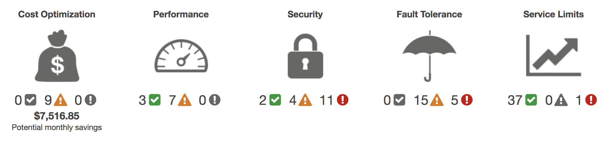
AWS Trusted Advisor
Online tool that provides real-time guidance to help you provision your resources following AWS best practices.
Looks at your entire AWS environment and gives you real-time recommendations in five categories.
AWS Trusted Advisor
Cost Optimization
Performance
Security
Fault Tolerance
Service Limits
Potential monthly savings
Notes:
AWS Trusted Advisor is an online tool that provides real-time guidance to help you provision your resources following AWS best practices.
AWS Trusted Advisor looks at your entire AWS environment and gives you recommendations in five categories:
Cost Optimization – AWS Trusted Advisor looks at your resource use and makes recommendations to help you optimize cost by eliminating unused and idle resources, or by making commitments to reserved capacity.
Performance – Improve the performance of your service by checking your service limits, ensuring you take advantage of provisioned throughput, and monitoring for overutilized instances.
Security – Improve the security of your application by closing gaps, enabling various AWS security features, and examining your permissions.
Fault Tolerance – Increase the availability and redundancy of your AWS application by taking advantage of automatic scaling, health checks, Multi-AZ deployments, and backup capabilities.
Service Limits – AWS Trusted Advisor checks for service usage that is more than 80 percent of the service limit. Values are based on a snapshot, so your current usage might differ. Limit and usage data can take up to 24 hours to reflect any changes.
For a detailed description of the information that AWS Trusted Advisor provides, see AWS Trusted Advisor Best Practice Checks at https://docs.aws.amazon.com/awssupport/latest/user/trusted-advisor-check-reference.html.

Slide 42
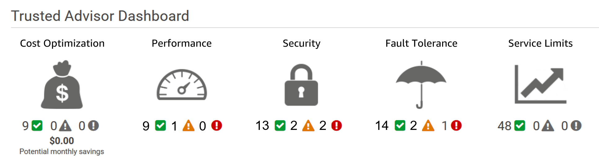
Activity: Interpret AWS Trusted Advisor recommendations
Notes:
You have a friend who used AWS Trusted Advisor for the first time. She is trying to interpret its recommendations to improve her cloud environment and needs your help. This is her dashboard. While everything looks OK in the cost optimization and service limit categories, you notice that there are a few recommendations that you should review to help her improve her security, performance, and fault tolerance.
Help your friend interpret the following recommendations.

Slide 43
Section 3 key takeaways
AWS Trusted Advisor is an online tool that provides real-time guidance to help you provision your resources by following AWS best practices.
AWS Trusted Advisor looks at your entire AWS environment and gives you real-time recommendations in five categories.
You can use AWS Trusted Advisor to help you optimize your AWS environment as soon as you start implementing your architecture designs.
Notes:
Some key takeaways from this section of the module include:
AWS Trusted Advisor is an online tool that provides real-time guidance to help you provision your resources by following AWS best practices.
AWS Trusted Advisor looks at your entire AWS environment and gives you real-time recommendations in five categories.
You can use AWS Trusted Advisor to help you optimize your AWS environment as soon as you start implementing your architecture designs.

Slide 44
Module wrap-up
Module 9: Cloud Architecture
Notes:
It’s now time to review the module and wrap up the module with a knowledge check and discussion of a practice certification exam question.

Slide 45
Module summary
In summary, in this module you learned how to:
Describe the AWS Well-Architected Framework, including the six pillars
Identify the design principles of the AWS Well-Architected Framework
Explain the importance of reliability and high availability
Identify how AWS Trusted Advisor helps customers
Interpret AWS Trusted Advisor recommendations
Notes:
In summary, in this module you learned how to:
Describe the AWS Well-Architected Framework, including the six pillars
Identify the design principles of the AWS Well-Architected Framework
Explain the importance of reliability and high availability
Identify how AWS Trusted Advisor helps customers
Interpret AWS Trusted Advisor recommendations

Slide 46
Module 10: Automatic Scaling and Monitoring
AWS Academy Cloud Foundations
Notes:
Welcome to Module 10: Automatic Scaling and Monitoring

Slide 47
Module overview
Topics
Elastic Load Balancing
Amazon CloudWatch
Amazon EC2 Auto Scaling
Activities
Elastic Load Balancing activity
Amazon CloudWatch activity
Lab
Scale and Load Balance Your Architecture
Knowledge check
Notes:
This module will address the following topics:
Elastic Load Balancing
Amazon CloudWatch
Amazon EC2 Auto Scaling
The module also includes two activities. One activity will challenge you to indicate Elastic Load Balancing use cases. The other activity will challenge you to identify Amazon CloudWatch examples.
The module also includes a hands-on lab where you will use Amazon EC2 Auto Scaling, Elastic Load Balancing, and Amazon CloudWatch together to create a dynamically scalable architecture.
Finally, you will be asked to complete a knowledge check that will test your understanding of key concepts that are covered in this module.

Slide 48
Module objectives
After completing this module, you should be able to:
Indicate how to distribute traffic across Amazon Elastic Compute Cloud (Amazon EC2) instances by using Elastic Load Balancing
Identify how Amazon CloudWatch enables you to monitor AWS resources and applications in real time
Explain how Amazon EC2 Auto Scaling launches and releases servers in response to workload changes
Perform scaling and load balancing tasks to improve an architecture
Notes:
After completing this module, you should be able to:
Indicate how to distribute traffic across Amazon Elastic Compute Cloud (Amazon EC2) instances by using Elastic Load Balancing
Identify how Amazon CloudWatch enables you to monitor AWS resources and applications in real time
Explain how Amazon EC2 Auto Scaling launches and releases servers in response to workload changes
Perform scaling and load balancing tasks to improve an architecture

Slide 49
Section 1: Elastic Load Balancing
Module 10: Automatic Scaling and Monitoring
Notes:
Section 1: Elastic Load Balancing

Slide 50





Elastic Load Balancing
Distributes incoming application or network traffic across multiple targets in a single Availability Zone or across multiple Availability Zones.
Scales your load balancer as traffic to your application changes over time.
Elastic Load
Balancing
IP addresses
Containers
Lambda functions
EC2 instances
Notes:
Modern high-traffic websites must serve hundreds of thousands—if not millions—of concurrent requests from users or clients, and then return the correct text, images, video, or application data in a fast and reliable manner. Additional servers are generally required to meet these high volumes.
Elastic Load Balancing is an AWS service that distributes incoming application or network traffic across multiple targets—such as Amazon Elastic Compute Cloud (Amazon EC2) instances, containers, internet protocol (IP) addresses, and Lambda functions—in a single Availability Zone or across multiple Availability Zones. Elastic Load Balancing scales your load balancer as traffic to your application changes over time. It can automatically scale to most workloads.

Slide 51
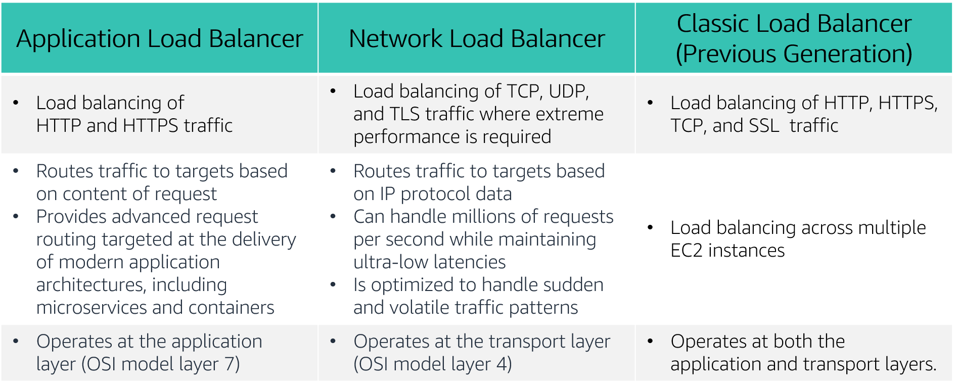
Types of load balancers
Notes:
Elastic Load Balancing is available in three types:
An Application Load Balancer operates at the application level (Open Systems Interconnection, or OSI, model layer 7). It routes traffic to targets—Amazon Elastic Compute Cloud (Amazon EC2) instances, containers, Internet Protocol (IP) addresses, and Lambda functions—based on the content of the request. It is ideal for advanced load balancing of Hypertext Transfer Protocol (HTTP) and Secure HTTP (HTTPS) traffic. An Application Load Balancer provides advanced request routing that is targeted at delivery of modern application architectures, including microservices and container-based applications. An Application Load Balancer simplifies and improves the security of your application by ensuring that the latest Secure Sockets Layer/Transport Layer Security (SSL/TLS) ciphers and protocols are used at all times.
A Network Load Balancer operates at the network transport level (OSI model layer 4), routing connections to targets—EC2 instances, microservices, and containers—based on IP protocol data. It works well for load balancing both Transmission Control Protocol (TCP) and User Datagram Protocol (UDP) traffic. A Network Load Balancer is capable of handling millions of requests per second while maintaining ultra-low latencies. A Network Load Balancer is optimized to handle sudden and volatile network traffic patterns.
A Classic Load Balancer provides basic load balancing across multiple EC2 instances, and it operates at both the application level and network transport level. A Classic Load Balancer supports the load balancing of applications that use HTTP, HTTPS, TCP, and SSL. The Classic Load Balancer is an older implementation. When possible, AWS recommends that you use a dedicated Application Load Balancer or Network Load Balancer.
To learn more about the differences between the three types of load balancers, see Product comparisons on the Elastic Load Balancing Features Page https://aws.amazon.com/elasticloadbalancing/features/?nc=sn&loc=2.

Slide 52

Application Load Balancer
“How may I direct your call?”

Slide 53

Network Load Balancer
“How can I process this the fastest?”

Slide 54

Classic Load Balancer
“I can do it all but it’s going to be slower and crummier!”

Slide 55


How Elastic Load Balancing works
With Application Load Balancers and Network Load Balancers, you register targets in target groups, and route traffic to the target groups.
With Classic Load Balancers, you register instances with the load balancer.
AWS Cloud
Load balancer accepts incoming traffic from clients.
Availability Zone A
Availability Zone B
Listener
Listener checks for connection requests.
Listener
Load balancer routes traffic only to healthy targets.
Load balancer performs health checks to monitor health of registered targets.
.
.
.
.
X
Target
Target
Target
Target
Target
Notes:
A load balancer accepts incoming traffic from clients and routes requests to its registered targets (such as EC2 instances) in one or more Availability Zones.
You configure your load balancer to accept incoming traffic by specifying one or more listeners. A listener is a process that checks for connection requests. It is configured with a protocol and port number for connections from clients to the load balancer. Similarly, it is configured with a protocol and port number for connections from the load balancer to the targets.
You can also configure your load balancer to perform health checks, which are used to monitor the health of the registered targets so that the load balancer only sends requests to the healthy instances. When the load balancer detects an unhealthy target, it stops routing traffic to that target. It then resumes routing traffic to that target when it detects that the target is healthy again.
There is a key difference in how the load balancer types are configured. With Application Load Balancers and Network Load Balancers, you register targets in target groups, and route traffic to the target groups. With Classic Load Balancers, you register instances with the load balancer.

Slide 56



Elastic Load Balancing use cases
Highly available and fault-tolerant applications
Containerized applications
Elasticity and scalability
Virtual private cloud (VPC)
Hybrid environments
Invoke Lambda functions over HTTP(S)
Notes:
There are many reasons to use a load balancer:
Achieve high availability and better fault tolerance for your applications – Elastic Load Balancing balances traffic across healthy targets in multiple Availability Zones. If one or more of your targets in a single Availability Zone are unhealthy, Elastic Load Balancing will route traffic to healthy targets in other Availability Zones. After the targets return to a healthy state, load balancing will automatically resume traffic to them.
Automatically load balance your containerized applications – With enhanced container support for Elastic Load Balancing, you can now load balance across multiple ports on the same EC2 instance. You can also take advantage of deep integration with Amazon Elastic Container Service (Amazon ECS), which provides a fully-managed container offering. You only need to register a service with a load balancer, and Amazon ECS transparently manages the registration and de-registration of Docker containers. The load balancer automatically detects the port and dynamically reconfigures itself.
Automatically scale your applications – Elastic Load Balancing works with Amazon CloudWatch and Amazon EC2 Auto Scaling to help you scale your applications to the demands of your customers. Amazon CloudWatch alarms can trigger auto scaling for your EC2 instance fleet when the latency of any one of your EC2 instances exceeds a preconfigured threshold. Amazon EC2 Auto Scaling then provisions new instances and your applications will be ready to serve the next customer request. The load balancer will register the EC2 instance and direct traffic to it as needed.
Use Elastic Load Balancing in your virtual private cloud (VPC) – You can use Elastic Load Balancing to create a public entry point into your VPC, or to route request traffic between tiers of your application within your VPC. You can assign security groups to your load balancer to control which ports are open to a list of allowed sources. Because Elastic Load Balancing works with your VPC, all your existing network access control lists (network ACLs) and routing tables continue to provide additional network controls. When you create a load balancer in your VPC, you can specify whether the load balancer is public (default) or internal. If you select internal, you do not need to have an internet gateway to reach the load balancer, and the private IP addresses of the load balancer will be used in the load balancer’s Domain Name System (DNS) record.
Enable hybrid load balancing – Elastic Load Balancing enables you to load balance across AWS and on-premises resources by using the same load balancer. For example, if you must distribute application traffic across both AWS and on-premises resources, you can register all the resources to the same target group and associate the target group with a load balancer. Alternatively, you can use DNS-based weighted load balancing across AWS and on-premises resources by using two load balancers, with one load balancer for AWS and other load balancer for on-premises resources. You can also use hybrid load balancing to benefit separate applications where one application is in a VPC and the other application is in an on-premises location. Put the VPC targets in one target group and the on-premises targets in another target group, and then use content-based routing to route traffic to each target group.
Invoking Lambda functions over HTTP(S) – Elastic Load Balancing supports invoking Lambda functions to serve HTTP(S) requests. This enables users to access serverless applications from any HTTP client, including web browsers. You can register Lambda functions as targets and use the support for content-based routing rules in Application Load Balancers to route requests to different Lambda functions. You can use an Application Load Balancer as a common HTTP endpoint for applications that use servers and serverless computing. You can build an entire website by using Lambda functions, or combine EC2 instances, containers, on-premises servers, and Lambda functions to build applications.

Slide 57

Load balancer monitoring
Amazon CloudWatch metrics – Used to verify that the system is performing as expected and creates an alarm to initiate an action if a metric goes outside an acceptable range.
Access logs – Capture detailed information about requests sent to your load balancer.
AWS CloudTrail logs – Capture the who, what, when, and where of API interactions in AWS services.
Notes:
You can use the following features to monitor your load balancers, analyze traffic patterns, and troubleshoot issues with your load balancers and targets:
Amazon CloudWatch metrics – Elastic Load Balancing publishes data points to Amazon CloudWatch for your load balancers and your targets. CloudWatch enables you to retrieve statistics about those data points as an ordered set of time series data, known as metrics. You can use metrics to verify that your system is performing as expected. For example, you can create a CloudWatch alarm to monitor a specified metric and initiate an action (such as sending a notification to an email address) if the metric goes outside what you consider an acceptable range.
Access logs – You can use access logs to capture detailed information about the requests that were made to your load balancer and store them as log files in Amazon Simple Storage Service (Amazon S3). You can use these access logs to analyze traffic patterns and to troubleshoot issues with your targets or backend applications.
AWS CloudTrail logs – You can use AWS CloudTrail to capture detailed information about the calls that were made to the Elastic Load Balancing application programming interface (API) and store them as log files in Amazon S3. You can use these CloudTrail logs to determine who made the call, what calls were made, when the call was made, the source IP address of where the call came from, and so on.

Slide 58
Section 1 key takeaways
Elastic Load Balancing distributes incoming application or network traffic across multiple targets in one or more Availability Zones.
Elastic Load Balancing supports three types of load balancers:
Application Load Balancer
Network Load Balancer
Classic Load Balancer
ELB offers instance health checks, security, and monitoring.
Notes:
Some key takeaways from this section of the module include:
Elastic Load Balancing distributes incoming application or network traffic across multiple targets (such as Amazon EC2 instances, containers, IP addresses, and Lambda functions) in one or more Availability Zones.
Elastic Load Balancing supports three types of load balancers:
Application Load Balancer
Network Load Balancer
Classic Load Balancer
Elastic Load Balancing offers several monitoring tools for continuous monitoring and logging for auditing and analytics.

Slide 59
Section 2: Amazon CloudWatch
Module 10: Automatic Scaling and Monitoring
Notes:
Section 2: Amazon CloudWatch

Slide 60
Monitoring AWS resources
To use AWS efficiently, you need insight into your AWS resources:
How do you know when you should launch more Amazon EC2 instances?
Is your application's performance or availability being affected by a lack of sufficient capacity?
How much of your infrastructure is actually being used?
Notes:
To use AWS efficiently, you need insight into your AWS resources.
For example, you might want to know:
When you should launch more Amazon EC2 instances?
If your application’s performance or availability is being affected by a lack of sufficient capacity?
How much of your infrastructure is actually being used?
How do you capture this information?

Slide 61



Amazon CloudWatch
Monitors –
AWS resources
Applications that run on AWS
Collects and tracks –
Standard metrics
Custom metrics
Alarms –
Send notifications to an Amazon SNS topic
Perform Amazon EC2 Auto Scaling or Amazon EC2 actions
Events –
Define rules to match changes in AWS environment and route these events to one or more target functions or streams for processing
Amazon
CloudWatch
Notes:
You can capture this information with Amazon CloudWatch.
Amazon CloudWatch is a monitoring and observability service that is built for DevOps engineers, developers, site reliability engineers (SRE), and IT managers. CloudWatch monitors your AWS resources (and the applications that you run on AWS) in real time. You can use CloudWatch to collect and track metrics, which are variables that you can measure for your resources and applications.
You can create an alarm to monitor any Amazon CloudWatch metric in your account and use the alarm to automatically send a notification to an Amazon Simple Notification Service (Amazon SNS) topic or perform an Amazon EC2 Auto Scaling or Amazon EC2 action. For example, you can create alarms on the CPU utilization of an EC2 instance, Elastic Load Balancing request latency, Amazon DynamoDB table throughput, Amazon Simple Queue Service (Amazon SQS) queue length, or even the charges on your AWS bill. You can also create an alarm on custom metrics that are specific to your custom applications or infrastructure.
You can also use Amazon CloudWatch Events to define rules that match incoming events (or changes in your AWS environment) and route them to targets for processing. Targets can include Amazon EC2 instances, AWS Lambda functions, Kinesis streams, Amazon ECS tasks, Step Functions state machines, Amazon SNS topics, Amazon SQS queues, and built-in targets. CloudWatch Events becomes aware of operational changes as they occur. CloudWatch Events responds to these operational changes and takes corrective action as necessary, by sending messages to respond to the environment, activating functions, making changes, and capturing state information.
With CloudWatch, you gain system-wide visibility into resource utilization, application performance, and operational health. There is no upfront commitment or minimum fee; you simply pay for what you use. You are charged at the end of the month for what you use.

Slide 62
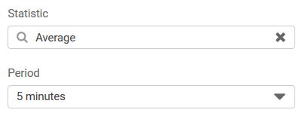
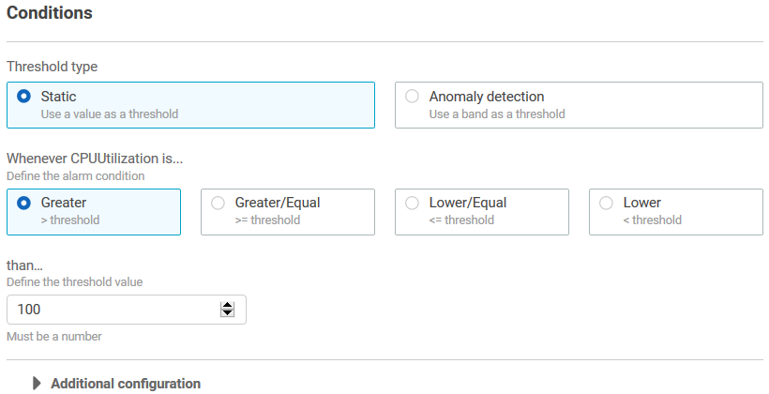
CloudWatch alarms
Create alarms based on –
Static threshold
Anomaly detection
Metric math expression
Specify –
Namespace
Metric
Statistic
Period
Conditions
Additional configuration
Actions
Notes:
You can create a CloudWatch alarm that watches a single CloudWatch metric or the result of a math expression based on CloudWatch metrics. You can create a CloudWatch alarm based on a static threshold, anomaly detection, or a metric math expression.
When you create an alarm based on a static threshold, you choose a CloudWatch metric for the alarm to watch and the threshold for that metric. The alarm goes to ALARM state when the metric breaches the threshold for a specified number of evaluation periods.
For an alarm based on a static threshold, you must specify the:
Namespace – A namespace contains the CloudWatch metric that you want, for example, AWS/EC2.
Metric – A metric is the variable you want to measure, for example, CPU Utilization.
Statistic – A statistic can be an average, sum, minimum, maximum, sample count, a predefined percentile, or a custom percentile.
Period – A period is the evaluation period for the alarm. When the alarm is evaluated, each period is aggregated into one data point.
Conditions – When you specify the conditions for a static threshold, you specify whenever the metric is Greater, Greater or Equal, Lower or Equal, or Lower than the threshold value, and you also specify the threshold value.
Additional configuration information – This includes the number of data points within the evaluation period that must be breached to trigger the alarm, and how CloudWatch should treat missing data when it evaluates the alarm.
Actions – You can choose to send a notification to an Amazon SNS topic, or to perform an Amazon EC2 Auto Scaling action or Amazon EC2 action.
For more information on creating CloudWatch alarms, see the topics under Using Alarms in the AWS Documentation at https://docs.aws.amazon.com/AmazonCloudWatch/latest/monitoring/AlarmThatSendsEmail.html.

Slide 63
Section 2 key takeaways
Amazon CloudWatch helps you monitor your AWS resources—and the applications that you run on AWS—in real time.
CloudWatch enables you to –
Collect and track standard and custom metrics.
Set alarms to automatically send notifications to SNS topics, or perform Amazon EC2 Auto Scaling or Amazon EC2 actions.
Define rules that match changes in your AWS environment and route these events to targets for processing.
Notes:
Some key takeaways from this section of the module include:
Amazon CloudWatch helps you monitor your AWS resources—and the applications that you run on AWS—in real time.
CloudWatch enables you to –
Collect and track standard and custom metrics.
Set alarms to automatically send notifications to SNS topics or perform Amazon EC2 Auto Scaling or Amazon EC2 actions based on the value of the metric or expression relative to a threshold over a number of time periods.
Define rules that match changes in your AWS environment and route these events to targets for processing.

Slide 64
Section 3: Amazon EC2 Auto Scaling
Module 10: Automatic Scaling and Monitoring
Notes:
Section 3: Amazon EC2 Auto Scaling
When you run your applications on AWS, you want to ensure that your architecture can scale to handle changes in demand. In this section, you will learn how to automatically scale your EC2 instances with Amazon EC2 Auto Scaling.

Slide 65
Why is scaling important?
Unused
capacity
Over
capacity
Su M T W Th F Sa
Su M T W Th F Sa
Used capacity (demand)
Provisioned capacity
Notes:
Scaling is the ability to increase or decrease the compute capacity of your application. To understand why scaling is important, consider this example of a workload that has varying resource requirements. In this example, the most resource capacity is required on Wednesday, and the least resource capacity is required on Sunday.
One option is to allocate more than enough capacity so you can always meet your highest demand—in this case, Wednesday. However, this situation means that you are running resources that will be underutilized most days of the week. With this option, your costs are not optimized.
Another option is to allocate less capacity to reduce costs. This situation means that you are under capacity on certain days. If you don't solve your capacity problem, your application could underperform or potentially even become unavailable for users.

Slide 66
Amazon EC2 Auto Scaling
Helps you maintain application availability
Enables you to automatically add or remove EC2 instances according to conditions that you define
Detects impaired EC2 instances and unhealthy applications, and replaces the instances without your intervention
Provides several scaling options – Manual, scheduled, dynamic or on-demand, and predictive
Su M T W Th F Sa
Used capacity (demand)
Provisioned capacity
Notes:
In the cloud, because computing power is a programmatic resource, you can take a flexible approach to scaling. Amazon EC2 Auto Scaling is an AWS service that helps you maintain application availability and enables you to automatically add or remove EC2 instances according to conditions you define. You can use the fleet management features of EC2 Auto Scaling to maintain the health and availability of your fleet.
Amazon EC2 Auto Scaling provides several ways to adjust scaling to best meet the needs of your applications. You can add or remove EC2 instances manually, on a schedule, in response to changing demand, or in combination with AWS Auto Scaling for predictive scaling. Dynamic scaling and predictive scaling can be used together to scale faster.
To learn more about Amazon EC2 Auto Scaling, see the Amazon EC2 Auto Scaling product page at https://aws.amazon.com/ec2/autoscaling .

Slide 67

Typical weekly traffic at Amazon.com
Provisioned capacity
Sunday
Monday
Tuesday
Wednesday
Thursday
Friday
Saturday
Notes:
Automatic scaling is useful for predictable workloads—for example, the weekly traffic at the retail company Amazon.com.

Slide 68


November traffic to Amazon.com
76 percent
Provisioned capacity
The challenge is to efficiently guess the unknown quantity of how much compute capacity you need.
24 percent
November
Notes:
Automatic scaling is also useful for dynamic on-demand scaling. Amazon.com experiences a seasonal peak in traffic in November (on Black Friday and Cyber Monday, which are days at the end of November when US retailers hold major sales). If Amazon provisions a fixed capacity to accommodate the highest use, 76 percent of the resources are idle for most of the year. Capacity scaling is necessary to support the fluctuating demands for service. Without scaling, the servers could crash due to saturation, and the business would lose customer confidence.

Slide 69


Auto Scaling groups
Auto Scaling group
An Auto Scaling group is a collection of EC2 instances that are treated as a logical grouping for the purposes of automatic scaling and management.
Minimum size
Launch or terminate instances as needed
Desired capacity
Maximum size
Notes:
An Auto Scaling group is a collection of Amazon EC2 instances that are treated as a logical grouping for the purposes of automatic scaling and management. The size of an Auto Scaling group depends on the number of instances you set as the desired capacity. You can adjust its size to meet demand, either manually or by using automatic scaling. See more about Auto Scaling Groups at https://docs.aws.amazon.com/autoscaling/ec2/userguide/auto-scaling-groups.html.
You can specify the minimum number of instances in each Auto Scaling group, and Amazon EC2 Auto Scaling is designed to prevent your group from going below this size. You can specify the maximum number of instances in each Auto Scaling group, and Amazon EC2 Auto Scaling is designed to prevent your group from going above this size. If you specify the desired capacity, either when you create the group or at any time afterwards, Amazon EC2 Auto Scaling is designed to adjust the size of your group so it has the specified number of instances. If you specify scaling policies, then Amazon EC2 Auto Scaling can launch or terminate instances as demand on your application increases or decreases.
For example, this Auto Scaling group has a minimum size of one instance, a desired capacity of two instances, and a maximum size of four instances. The scaling policies that you define adjust the number of instances within your minimum and maximum number of instances, based on the criteria that you specify.

Slide 70
Scaling out versus scaling in
Elastic Load Balancing
Auto Scaling group
Auto Scaling group
Auto Scaling group
Base configuration
Scale out (launch instances)
Scale in (terminate instances)
Notes:
With Amazon EC2 Auto Scaling, launching instances is referred to as scaling out, and terminating instances is referred to as scaling in.

Slide 71


How Amazon EC2 Auto Scaling works
What
Where
When
VPC
Maintain current number
Private subnet
Health checks
AMI
Auto Scaling group
Manual scaling
EC2 instance
Min, max, desired capacity
Scheduled scaling
Launch configuration
Auto Scaling group
Scheduled actions
AMI
Instance type
IAM role
Security groups
EBS volumes
VPC and subnets
Load balancer
Dynamic scaling
Scaling policies
Predictive scaling
AWS Auto Scaling
Notes:
To launch EC2 instances, an Auto Scaling group uses a launch configuration, which is an instance configuration template. You can think of a launch configuration as what you are scaling. When you create a launch configuration, you specify information for the instances. The information you specify includes the ID of the Amazon Machine Image (AMI), the instance type, AWS Identity and Access Management (IAM) role, additional storage, one or more security groups, and any Amazon Elastic Block Store (Amazon EBS) volumes. See more information on the launch configuration at https://docs.aws.amazon.com/autoscaling/ec2/userguide/launch-configurations.html.
You define the minimum and maximum number of instances and desired capacity of your Auto Scaling group. Then, you launch it into a subnet within a VPC (you can think of this as where you are scaling). Amazon EC2 Auto Scaling integrates with Elastic Load Balancing to enable you to attach one or more load balancers to an existing Auto Scaling group. After you attach the load balancer, it automatically registers the instances in the group and distributes incoming traffic across the instances.
Finally, you specify when you want the scaling event to occur. You have many scaling options:
Maintain current instance levels at all times – You can configure your Auto Scaling group to maintain a specified number of running instances at all times. To maintain the current instance levels, Amazon EC2 Auto Scaling performs a periodic health check on running instances in an Auto Scaling group. When Amazon EC2 Auto Scaling finds an unhealthy instance, it terminates that instance and launches a new one.
Manual scaling – With manual scaling, you specify only the change in the maximum, minimum, or desired capacity of your Auto Scaling group. See more on manual scaling at https://docs.aws.amazon.com/autoscaling/ec2/userguide/as-manual-scaling.html.
Scheduled scaling– With scheduled scaling, scaling actions are performed automatically as a function of date and time. This is useful for predictable workloads when you know exactly when to increase or decrease the number of instances in your group. For example, say that every week, the traffic to your web application starts to increase on Wednesday, remains high on Thursday, and starts to decrease on Friday. See more on scheduled scaling at https://docs.aws.amazon.com/autoscaling/ec2/userguide/ec2-auto-scaling-scheduled-scaling.html. You can plan your scaling actions based on the predictable traffic patterns of your web application. To implement scheduled scaling, you create a scheduled action.
– A more advanced way to scale your resources enables you to define parameters that control the scaling process. For example, you have a web application that currently runs on two instances and you want the CPU utilization of the Auto Scaling group to stay close to 50 percent when the load on the application changes. This option is useful for scaling in response to changing conditions, when you don't know when those conditions will change. Dynamic scaling gives you extra capacity to handle traffic spikes without maintaining an excessive amount of idle resources. You can configure your Auto Scaling group to scale automatically to meet this need. More on dynamic scaling at https://docs.aws.amazon.com/autoscaling/ec2/userguide/as-scale-based-on-demand.html. The scaling policy type determines how the scaling action is performed. You can use Amazon EC2 Auto Scaling with Amazon CloudWatch to trigger the scaling policy in response to an alarm. See policy types at https://docs.aws.amazon.com/autoscaling/ec2/userguide/as-scale-based-on-demand.html#as-scaling-types.
Predictive scaling – You can use Amazon EC2 Auto Scaling with AWS Auto Scaling to implement predictive scaling, where your capacity scales based on predicted demand. Predictive scaling uses data that is collected from your actual EC2 usage, and the data is further informed by billions of data points that are drawn from our own observations. AWS then uses well-trained machine learning models to predict your expected traffic (and EC2 usage), including daily and weekly patterns. The model needs at least 1 day of historical data to start making predictions. It is re-evaluated every 24 hours to create a forecast for the next 48 hours. The prediction process produces a scaling plan that can drive one or more groups of automatically scaled EC2 instances. See more on predictive scaling at https://aws.amazon.com/blogs/aws/new-predictive-scaling-for-ec2-powered-by-machine-learning/.
To learn more about these options, see Scaling the Size of Your Auto Scaling Group in the AWS Documentation at https://docs.aws.amazon.com/autoscaling/ec2/userguide/scale-your-group.html.

Slide 72



Implementing dynamic scaling
Elastic Load Balancing
Auto Scaling group
CPU utilization
If average CPU utilization is > 60% for 5 minutes…
Run Amazon EC2 Auto Scaling policy
Amazon EC2 Auto Scaling
Amazon CloudWatch
Notes:
One common configuration for implementing dynamic scaling is to create a CloudWatch alarm that is based on performance information from your EC2 instances or load balancer. When a performance threshold is breached, a CloudWatch alarm triggers an automatic scaling event that either scales out or scales in EC2 instances in the Auto Scaling group.
To understand how it works, consider this example:
You create an Amazon CloudWatch alarm to monitor CPU utilization across your fleet of EC2 instances and run automatic scaling policies if the average CPU utilization across the fleet goes above 60 percent for 5 minutes.
Amazon EC2 Auto Scaling instantiates a new EC2 instance into your Auto Scaling group based on the launch configuration that you create.
After the new instance is added, Amazon EC2 Auto Scaling makes a call to Elastic Load Balancing to register the new EC2 instance in that Auto Scaling group.
Elastic Load Balancing then performs the required health checks and starts distributing traffic to that instance. Elastic Load Balancing routes traffic between EC2 instances and feeds metrics to Amazon CloudWatch.
Amazon CloudWatch, Amazon EC2 Auto Scaling, and Elastic Load Balancing work well individually. Together, however, they become more powerful and increase the control and flexibility over how your application handles customer demand.

Slide 73

AWS Auto Scaling
Monitors your applications and automatically adjusts capacity to maintain steady, predictable performance at the lowest possible cost
Provides a simple, powerful user interface that enables you to build scaling plans for resources, including –
Amazon EC2 instances and Spot Fleets
Amazon Elastic Container Service (Amazon ECS) Tasks
Amazon DynamoDB tables and indexes
Amazon Aurora Replicas
AWS Auto Scaling
Notes:
So far, you learned about scaling EC2 instances with Amazon EC2 Auto Scaling. You also learned that you can use Amazon EC2 Auto Scaling with AWS Auto Scaling to perform predictive scaling.
AWS Auto Scaling is a separate service that monitors your applications. It automatically adjusts capacity to maintain steady, predictable performance at the lowest possible cost. The service provides a simple, powerful user interface that enables you to build scaling plans for resources, including:
Amazon EC2 instances and Spot Fleets
Amazon Elastic Container Service (Amazon ECS) tasks
Amazon DynamoDB tables and indexes
Amazon Aurora Replicas
If you are already using Amazon EC2 Auto Scaling to dynamically scale your EC2 instances, you can now use it with AWS Auto Scaling to scale additional resources for other AWS services.
To learn more information about AWS Auto Scaling, see AWS Auto Scaling at https://aws.amazon.com/autoscaling/.

Slide 74
Section 3 key takeaways
Scaling enables you to respond quickly to changes in resource needs.
Amazon EC2 Auto Scaling maintains application availability by automatically adding or removing EC2 instances.
An Auto Scaling group is a collection of EC2 instances.
A launch configuration is an instance configuration template.
Dynamic scaling uses Amazon EC2 Auto Scaling, CloudWatch, and Elastic Load Balancing.
AWS Auto Scaling is a separate service from Amazon EC2 Auto Scaling.
Notes:
Some key takeaways from this section of the module include:
Scaling enables you to respond quickly to changes in resource needs.
Amazon EC2 Auto Scaling helps you maintain application availability, and enables you to automatically add or remove EC2 instances according to your workloads.
An Auto Scaling group is a collection of EC2 instances.
A launch configuration is an instance configuration template.
You can implement dynamic scaling with Amazon EC2 Auto Scaling, Amazon CloudWatch, and Elastic Load Balancing.
AWS Auto Scaling is a separate service that monitors your applications, and it automatically adjusts capacity for the following resources:
Amazon EC2 instances and Spot Fleets
Amazon ECS tasks
Amazon DynamoDB tables and indexes
Amazon Aurora Replicas

Slide 75
Module wrap-up
Module 10: Automatic Scaling and Monitoring
Notes:
It’s now time to review the module, and wrap up with a knowledge check and discussion of a practice certification exam question.

Slide 76
Module summary
In summary, in this module you learned how to:
Indicate how to distribute traffic across Amazon Elastic Compute Cloud (Amazon EC2) instances using Elastic Load Balancing.
Identify how Amazon CloudWatch enables you to monitor AWS resources and applications in real time.
Explain how Amazon EC2 Auto Scaling launches and releases servers in response to workload changes.
Perform scaling and load balancing tasks to improve an architecture.
Notes:
In summary, in this module you learned how to:
Indicate how to distribute traffic across Amazon Elastic Compute Cloud (Amazon EC2) instances using Elastic Load Balancing.
Identify how Amazon CloudWatch enables you to monitor AWS resources and applications in real time
Explain how Amazon EC2 Auto Scaling launches and releases servers in response to workload changes.
Perform scaling and load balancing tasks to improve an architecture.

Slide 77
Final Project
“Building” a Data Pipeline
Notes:
Welcome to Module 10: Automatic Scaling and Monitoring

Slide 78



Our “Pipeline”
Transform CSV files into JSON and consolidate the information in them
“Uploads” Bucket
{ }
“JSON” Bucket
< />
“Reports” Bucket
{ }
{ }
{ }
CSV to JSON Lambda
JSON to HTML Lambda

Slide 79
Thank you
All trademarks are the property of their owners.
Notes:
Thank you for completing this module.

